Slide 1

SHARKTANK ASSIGNMENT
By- SAURABH SHARMA
MBA- BUSINESS ANALYTCS, BMU
REG. NO. 190A3010041

Slide 2
BACKGROUND
Shark Tank is a US based show wherein entrepreneurs and founders pitch their businesses in front of investors (aka Sharks) who decides to invest or not in the businesses based on multiple parameters.
Here, we have got an dataset containing Shark Tank episodes with 495 records where each entrepreneur making their pitch to investors (aka sharks). Using multiple algorithms, we will predict given the description of new pitch, how likely is the pitch will convert into success or not.

Slide 3

My APPROACH
CHECK FOR MISSING VALUES: NO MISSING VALUES IN DATA EXCEPT ENTREPRENEURS AND WEBSITE.
REMOVING UNNECESSARY COLUMNS i.e. website
TARGET VARIABLE - DEAL : CATEGORICAL, that means I will be using CLASSIFICATION TECHNIQUES and will try to sort the best algorithm.
TEXT ANALYSIS ON DESCRIPTION
WILL USE ASSOCIATION FOR FURTHER INSIGHTS.

Slide 4
Techniques USED :
LOGISTIC REGRESSION : 50.4% ACCURACY
SUPPORT VECTOR MACHINE : 48.7% ACCURACY
BOOSTED DECISION TREE : 52.2% ACCURACY
DECISION FOREST : 49.3% ACCURACY
BOOSTED DECISION TREE gives the highest accuracy among all but still it is very low. We will go for ASSOCIATION RULES NEXT.

Slide 5
ASSOCIATION RULE
TOTAL 6691 DIFFERENT RULES WERE CREATED USING APRIORI EXECUTION AT SUPPORT 0.01 and CONFIDENCE 0.07.
COLUMNS CHOOSED FOR ASSOCIATION :
Deal (Dependent var.)
Location
Category
Sharks (all)
Multiple Entrepreneurs
CONFIDENCE AND SUPPORT ARE MORE RELIABLE TOWARDS MY ANALYSIS TO MAKE CONCLUSION ON THE RULES.

Slide 6
CONCLUSION
There is 100% probability for those who had their product category as ‘Novelties’, didn’t have multiple entrepreneurs, and had Kevin O’Leary, Mark Cuban and Barbara Corcoran as the Sharks were given a Deal.
There is 100% probability for those who had their company Location as ‘San Diego, CA’ and had Lori Greiner, Robert Herjavec, Daymond John and Kevin O’Leary as the Sharks were given a Deal.
There is 100% probability for those who had products of category ‘Online Services’, were NOT multiple entrepreneurs and had Mark Cuban as a Shark were given a Deal.
There is 100% probability for those who had products of category ‘Furniture’ and were NOT multiple entrepreneurs were given a Deal.
There is 100% probability that when Shark 4 is Daymond John and Shark 5 is Mark Cuban then Shark 3 will be Kevin O’ Leary.
There is 100% probability that when Shark 1 is Barbara Corcoran and Shark 4 is Daymond John then Shark 2 will be Robert Herjavec

Slide 7
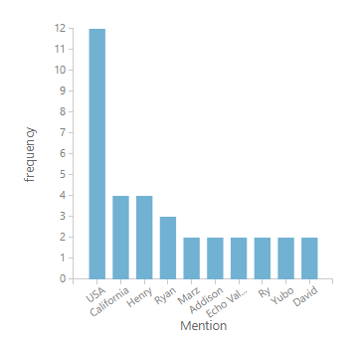
TEXT ANALYSIS : DESCRIPTION
LANGUAGE USED FOR DESCRIPTION IS ENGLISH
TOP 10 ENTITIES :
USA
California
Henry
Ryan
Marz
Addison
Echo Valley
Ry
Yubo
David

Slide 8
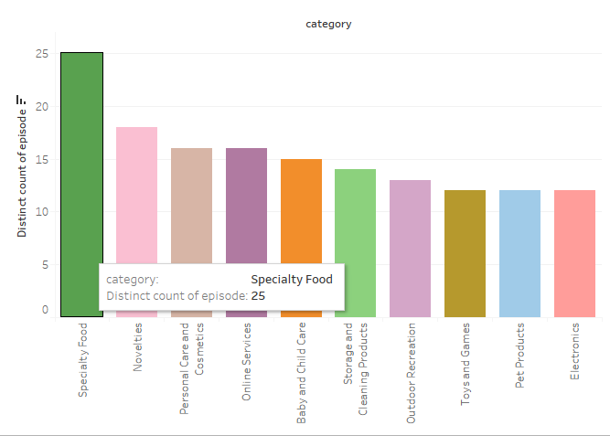
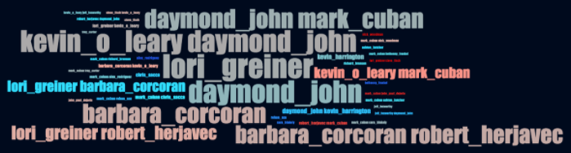
TOP 10 CATEGORIES BY EPISODES
Size of Shark names indicate how often they appear together on Shark Tank

Slide 9

EXPLORE :
VISIT THE GALLERY TO VIEW THE EXPERIMENT :
https://gallery.cortanaintelligence.com/Experiment/SHARKTANK-ALGO
https://gallery.cortanaintelligence.com/Experiment/SHARKTANK-TEXT-ANALYSIS

